Slide 1
Passwords Lab

Slide 2
Passwords Lab
Description of the lab
Materials needed
Kali Linux Machine
Software Tools used
Leafpad

Slide 3
Objectives Covered
Security+ Objectives (SY0-501)
Objective 4.4 – Given a scenario, differentiate common account management practices
Account Policy Enforcement
Password Complexity
Objective 6.1 – Compare and contrast basic concepts of cryptography
Hashing
Salt, IV, nonce

Slide 4
The Password Lab
Setup Environment
Navigate to Shadow
Exploring the Student Password
Creating a User
Creating a Password
Moving the Password
Testing the Password
On Your Own Activity

Slide 5
Setup Environment
Log into your range
Open the Kali Linux Environment
You should be on your Kali Linux Desktop
Open the Terminal

Slide 6
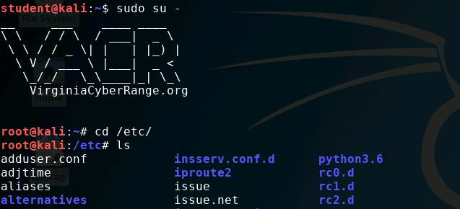
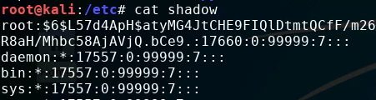
Navigate to Shadow
Make yourself the root user:
sudo su -
Change directory to the etc folder:
cd /etc/
Display all the directories within /etc:
ls
You should be able to see the shadow file
Read the Shadow file where the passwords are stored:
cat shadow
Notice that the users root and student have passwords stored

Slide 7
Exploring the student password
Take a look at the student password
Remember, “student” is the password
What does all of this mean?

Slide 8
Exploring the student password
Take a look at the student password
Remember, “student” is the password
The user’s name

Slide 9
Exploring the student password
Take a look at the student password
Remember, “student” is the password
The Hash Algorithm
(Here it is 6, thus using SHA-512 Algorithm)
$1$ → MD5
$2$ → Blowfish
$2a$ → ekaBlowfish
$5$ → SHA-256
$6$ → SHA-512

Slide 10
Exploring the student password
Take a look at the student password
Remember, “student” is the password
The Salt
What is the purpose of a salt? Why is this important for security?

Slide 11
Exploring the student password
Take a look at the student password
Remember, “student” is the password
The Hashed Password
What is a hashed password and why are passwords stored like this?

Slide 12
Exploring the student password
Thus, passwords are stored in the following format:
username: $hash number$salt$hashed password:
Student has the following data:
username = student
Hash Algorithm = 6 or SHA-512
Hash is ‘EGEvqThV’
Plaintext password is ‘student’

Slide 13


Creating a User
Create a new user with the same hash and password as ‘student’
Create a new user:
useradd johnsmith
Now, check out johnsmith’s data:
cat shadow
Notice, that johnsmith has a “!” where the password should be stored
No stored password

Slide 14
Creating a Password
Use the following command to make the same password as the student account:
mkpasswd -m sha-512 -S EGEvqThV -s student
Password is student
(-s stands for standard input)
Method SHA-512
Salt is EGEvqThV
Make password
Notice, the password created is the same as the original student

Slide 15
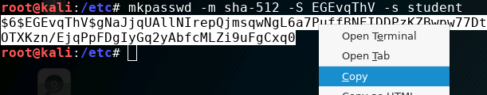


Moving the Password
Highlight the entire password
Right-click, and select “copy”
Open shadow in Leafpad:
leafpad shadow
Navigate to user johnsmith
Delete the exclamation mark
Paste in the password
Save and exit Leafpad!
Only replace the ‘!’

Slide 16
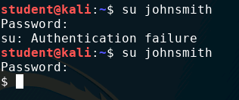
Test the password
Open a new Terminal (should not be root access)
Switch user to johnsmith:
su johnsmith
When prompted, enter the wrong password
Do not type in ‘student’
You should see “Authentication failure”
Switch user to johnsmith:
su johnsmith
Now type in ‘student’ as the password
You should notice that it gave you access to johnsmith account!

Slide 17
On Your Own Activity
Try and make passwords for the following:
Create your own SHA-512 password with a different salt
A different password using MD5 Algorithm (-m md5)
Another password using SHA-256 Algorithm (-m SHA-256)
Here was the command we used to create the student password:
mkpasswd -m sha-512 -S EGEvqThV -s student
Remember to check to make sure the password works!

